Slide 1
TASK 1: MOBILE APPLICATIONS DEVELOPMENT PROCESS
PRESENTED BY GROUP 1
EBAN BORIS MANYO(SENG22SE06)
AKWUNG GABRIELSENG22TE001)
NYENTY OBI RAMSON(SENG22SE08)
IKOME M.B JOHNSON( SENG22SE007)
COURSE TITLE: Internet Programming & Mobile Programming
COURSE CODE: CEB402
COURSE INSTRUCTOR: DR. VALERY NKEMINI

Slide 2

Mobile Applications: A Comprehensive Overview
The mobile app market is booming, valued at $208.8B in 2024. There are 255 billion mobile app downloads worldwide. This is due to 6.3 billion smartphone users globally. These apps are essential to modern life. From entertainment to productivity, apps connect the world.
ij

Slide 3

Mobile App Programming Languages
Native Languages
iOS: Swift, Objective-C
Android: Kotlin, Java
Cross-Platform Languages
JavaScript
Dart
C#
Native languages are tailored for specific platforms. Cross-platform languages enable broader reach with shared codebases. Each language offers unique strengths for mobile development.

Slide 4

Mobile App Development Frameworks
Flutter (Google)
React Native (Facebook)
A popular cross-platform framework known for its fast development and expressive UI.
Uses JavaScript to build native mobile apps with a focus on efficiency.
Xamarin (Microsoft)
Leverages C# for cross-platform development, providing robust performance.
These frameworks streamline development, promote code reuse, and accelerate time-to-market.

Slide 5


Native vs Cross-Platform Development
Native
Cross-Platform
Platform-specific
Single codebase
Top performance
Fast time-to-market
Full device access
Cost-effective
Native development excels in performance. Cross-platform offers efficiency and broad compatibility. Choosing the right approach depends on project goals and resources.

Slide 6

Mobile App Architectures
MVC
MVVM
Model-View-Controller: Separates data, UI, and control logic.
Model-View-ViewModel: Enhances testability and data binding.
Clean Architecture
Focuses on separation of concerns and independent layers.
Well-defined architectures are vital for maintainable and scalable mobile applications, improving code organization and testability.

Slide 7
Requirement Engineering Process
1
User Research
2
Requirements
3
Prototyping
Start with user research. Define functional and non-functional requirements. Create prototypes and get feedback. Refine iteratively. Effective requirement engineering is essential for project success.

Slide 8




Mobile App Design Patterns
Singleton
Factory
1
2
4
3
Adapter
Observer
Apply Singleton for unique instances. Use Factory for object creation. Implement Observer for event handling. Employ Adapter for interface compatibility. Design patterns boost modularity and code reuse.

Slide 9
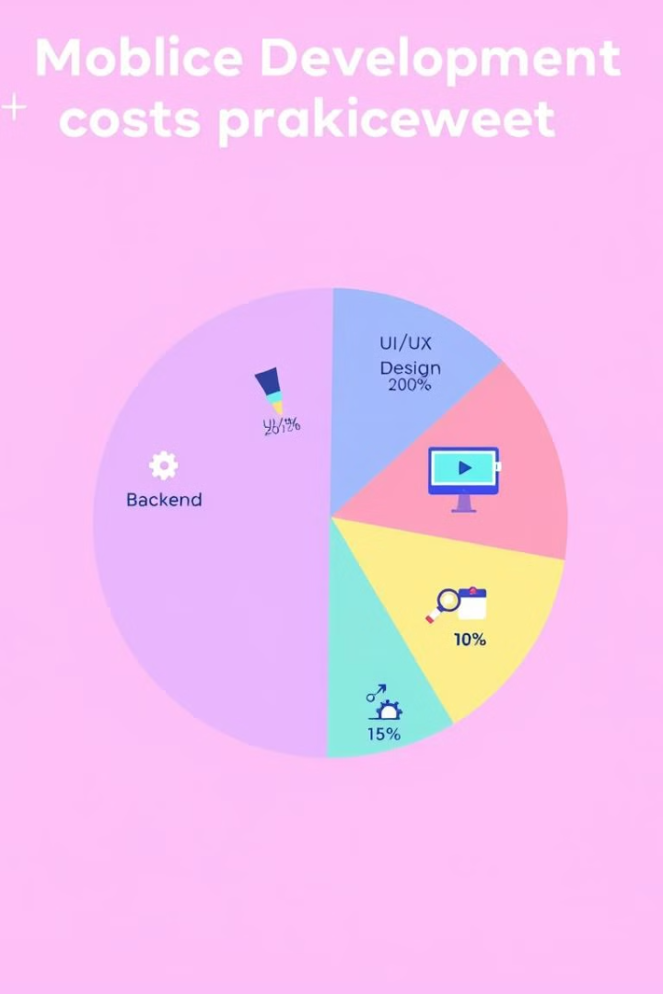
Mobile App Development Cost Estimation
$5K-$50K
$50K-$250K
Basic App
Complex App
Simple features. Limited complexity.
Advanced functionality. Custom design.
$250K-$1M
Enterprise App
High security. Scalability needs.

Slide 10
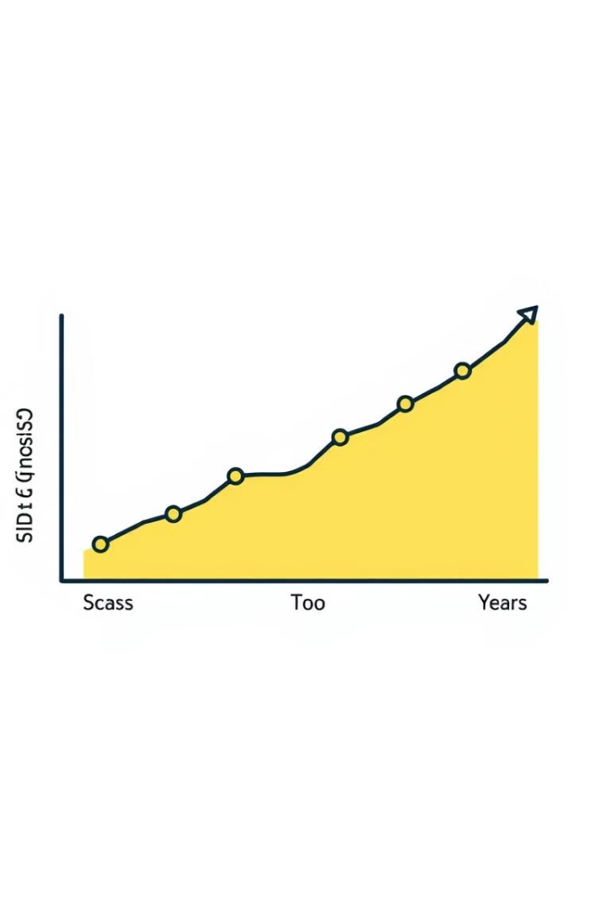
Mobile App Development Cost Estimation
$10K-$250K
High
Typical Range
Complexity
Varied
Design
Platform, complexity, design, and backend impact costs. The range can vary widely based on project scope. Careful planning and analysis are crucial for accurate estimation.

Slide 11




Emerging Trends in Mobile Development
AI Integration
AR Features
IoT Connectivity
AI enhances app intelligence. AR offers immersive experiences. IoT connectivity expands functionality. Security protocols are critical. Performance optimization improves user satisfaction.

Slide 12

Future of Mobile Applications
The mobile app market will grow at 7.84% annually. User experience remains key. Privacy and security are paramount. Continuous innovation drives the future. Staying ahead requires adaptability and foresight.

